Slide 1


Slide 2
Bike Rental Analysis Overview
58,304
53,383
4,921
5:00 PM
CLEAR
TOTAL RIDERS
REGISTERED RIDERS
CASUAL RIDERS
PEAK HOUR
COMMON WEATHER
Recorded rider count
91.56% of total
8.44% of total
140.2 avg. riders/hour
Dashboard’s most common
INSIGHTS:
01
CUSTOMER MIX
02
DEMAND
03
WEATHER PATTERN
Registered users account for 53,383 riders (91.56%), compared with 4,921 casual riders (8.44%).
Hourly average demand peaks at 5:00 PM (140.2 riders), followed by 8:00 AM (128.3 riders).
Clear weather is the dashboard’s most common condition; clear-weather observations average about 61.7 riders per recorded hour.
BUSINESS IMPLICATION Prioritize retention and reliability for registered users while exploring ways to convert casual riders.
BUSINESS IMPLICATION Evaluate staffing and bike availability around morning and evening peaks.
BUSINESS IMPLICATION Align bike availability and operational planning with expected weather conditions
01

Slide 3
Bike Rental Analysis Overview
WEEKDAY VS. WEEKEND
MONTHLY DEMAND MOVEMENT
01
Weekday-led demand
Weekday
63.3
January
1,312
Weekdays average 31.7% above weekends
Weekend
48.1
February
1,518
Weather sensitivity
02
Clear weather records (67.4%) of riders, followed by Mist with (32.6%), while Rain and Storm conditions account for much lower rider volumes.
Weekday demand is 31.7% higher.
February is up 15.7% vs. January on these days.
WEATHER VS DEMAND
TEMPERATURE VS DEMAND
03
Temperature
Rider demand is highest at temperatures of 12–22°C (25,413 riders), while extreme cold (2–12°C) and high temperatures (42–52°C) see lower Demand.
04
Monthly direction
Average daily total rises 15.7% from January to February.

Slide 4
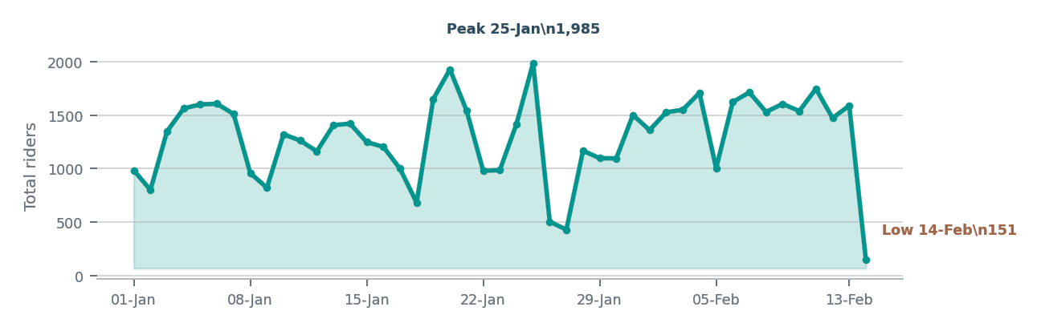
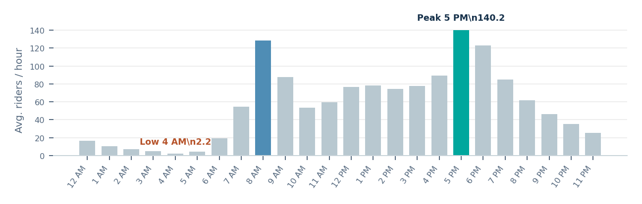
Bike Rental Analysis | Demand Patterns
01
DAILY DEMAND TREND
02
DEMAND BY HOUR
INSIGHTS: DAILY VS HOURLY DEMAND
01
DAILY SPIKE & DIP
02
HOURLY PEAK
03
OVERNIGHT LOW
Overnight demand is lowest at 4 AM (2.2 average riders/hour). Prioritize bike availability and staffing during the morning and evening peak hours.
Daily demand peaked on 25-Jan at 1,985 riders.
The lowest recorded day was 14-Feb (151);
demand fell sharply after the Jan 25 peak.
The strongest hour is 5 PM (140.2 average
riders/hour), with a second surge at 8 AM (128.3).
02

Slide 5
Bike Rental Analysis | Weather & Rider Correlation
01
TEMPERATURE VS RIDERS
02
HUMIDITY VS RIDERS
INSIGHTS: WEATHER VS RIDER DEMAND
The downward trend indicates a negative association, with rider counts generally decreasing as humidity increases.
01
TEMPERATURE
02
HUMIDITY
03
BUSINESS INSIGHTS
The upward trend indicates a positive association,
with rider counts generally increasing as temperatures rise.
.
The downward trend indicates a negative association, with rider counts generally decreasing as humidity increases.
Bike rental demand tends to be higher at warmer
temperatures and lower under more humid
conditions, indicating that weather conditions
are associated with changes in rider activity.
03

Slide 6
Bike Rental Analysis | Demand Forecasting
Early February shows high
swings characterized by
sudden contractions rider
volume on Feb 14.
01
Model projects an immediate
rebound on Feb 15 to 1,105 riders
02
Mid-to-late February
Forecasts a controlled, gradual
normalization curve
03
03

Slide 7
Bike Rental Analysis | Anomaly detection
Daily rider count vs. thresholds
ANOMALY INSIGHTS
What stands out in the data
3000
01
Anomaly
On February 14, the total rider count dropped to 151, falling below the lower threshold.
2500
2000
02
Anomaly Cause
1500
Hourly data from 8 AM to 11 PM is missing for Feb 14, resulting in an incomplete rider count of 151. No other cause for the anomaly was identified.
1000
500
0
1 Jan
4 Jan
7 Jan
10 Jan
13 Jan
16 Jan
19 Jan
22 Jan
25 Jan
28 Jan
31 Jan
3 Feb
6 Feb
9 Feb
12 Feb
14 Feb
Daily total
Upper threshold: 2,400
Lower threshold: 151

Slide 8
Business Insights | Challenges
KEY HIGHLIGHTS
Demand is stronger on weekdays and in clear conditions.
BUSINESS DIFFICULTY
HOW TO OVERCOME IT
1
Uneven demand across the week
Adjust bike availability and staff numbers based on weekday and weekend demand. Test special weekend offers and compare ridership with normal weekends to see if they increase usage.
Weekends average 31.7% fewer riders per hour than weekdays.
2
Weather-linked demand swings
Adjust bike availability and staffing based on weather forecasts, and schedule regular fleet maintenance to prevent breakdowns and service delays.
Rain demand averages 46.2% below clear conditions; high-humidity records also show lower average demand.
Demand changes with temperature
Monitor rider comfort during extreme heat and cold, and introduce measures such as shaded rest stops, hydration points, and weather-appropriate riding guidance to make riding more comfortable
3
Extreme temperatures contribute, with only 1.68% of demand at 42–52°C and 4.77% at 2–12°C to overall ridership
Priority: match fleet and staffing to weekday demand, plan for weather-related dips, and test targeted weekend initiatives using measured results.

